Slide 1
Intro to Unity

Slide 2

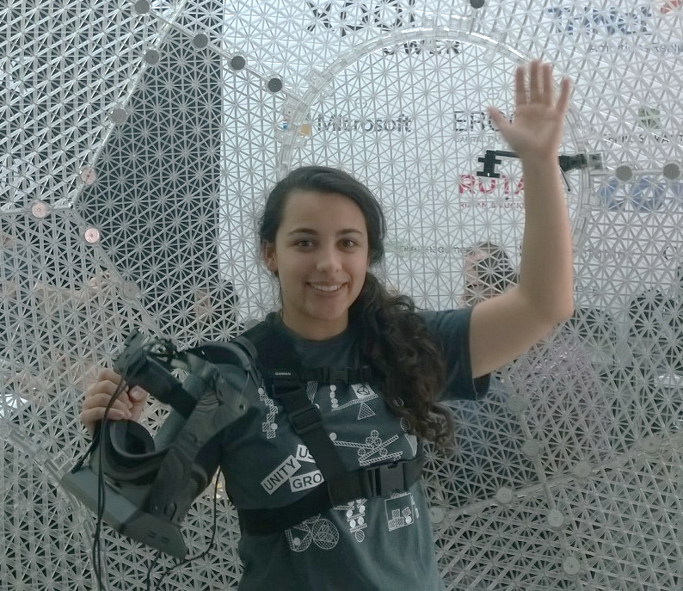
Katherine (Kat) Harris
Twitter: @KatVHarris
Blog: http://kaharri.com
Email: kaharri@Microsoft.com
GitHub:
https://github.com/KatVHarris/
Notes:
ME
GitHub
Unite
AUDIENCE
Now before we get to that I wanted to talk to you I wanted to tell you a little about myself and why I wanted to talk to you about this topic. As I mentioned before I’m an evangelist at Microsoft. Does anyone know what that is? It means that I get to play with cool technology and gamify almost anything I can get my hands on. As well as teaching others how to do the same. So everything I talk about will be released on my blog next week. And the base project for what I do is on github. I use that project as a simple Unity game.
I recently made a Kinect and Oculus integrated infinite runner. And after I completed it I wanted to release it into the store. But before I could I went to Unite Unity’s Dev conference in Boston. I learned about there new analytics and ads systems. And how the pay off of using these sytems was so large with virtual no overhead. So that’s what I’m going to show you today.

Slide 3

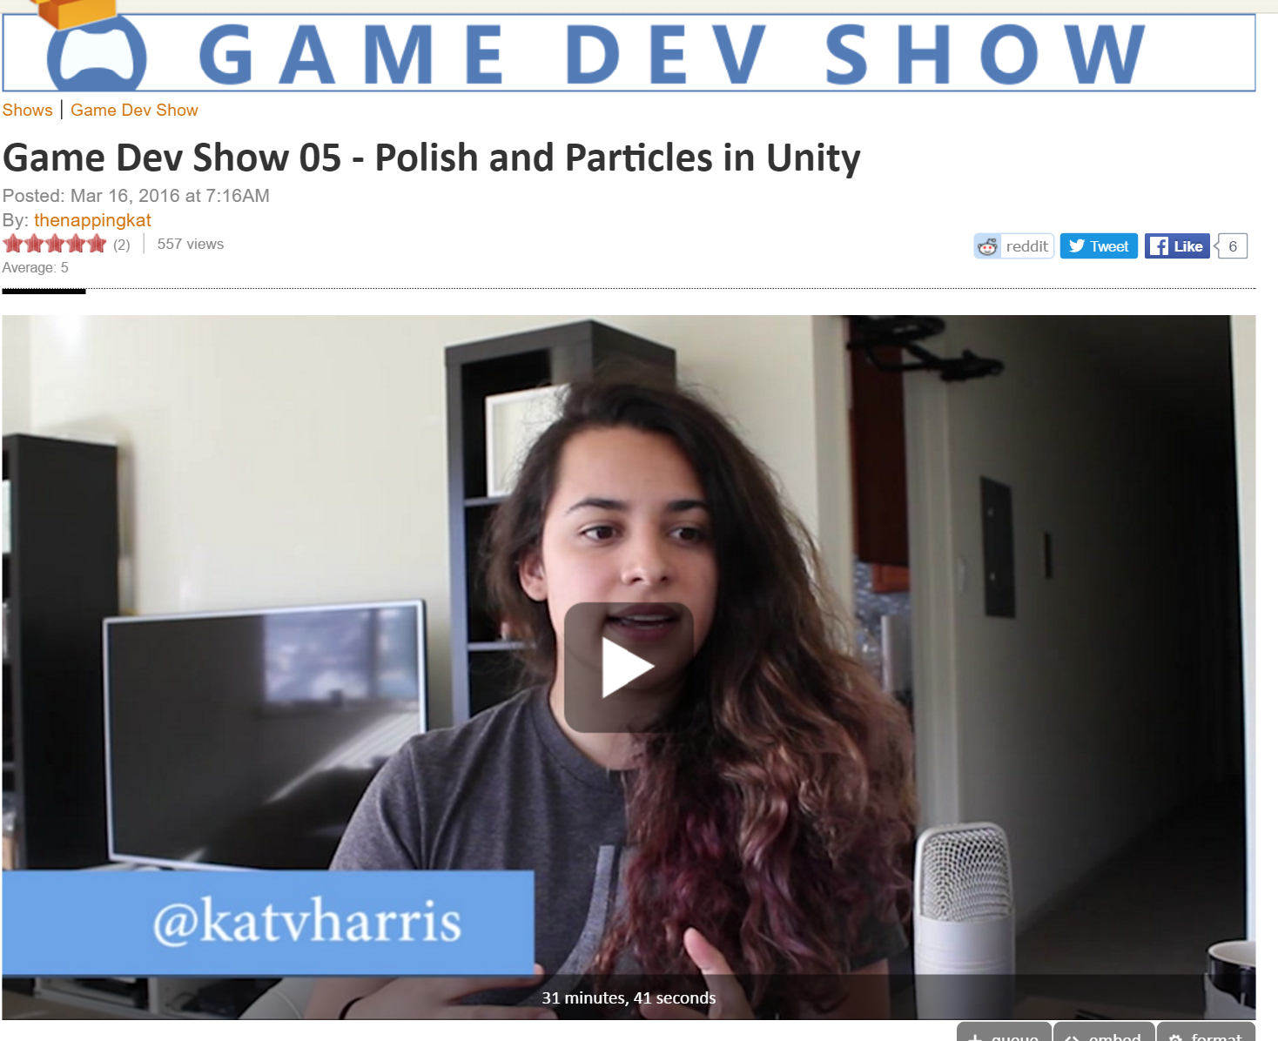

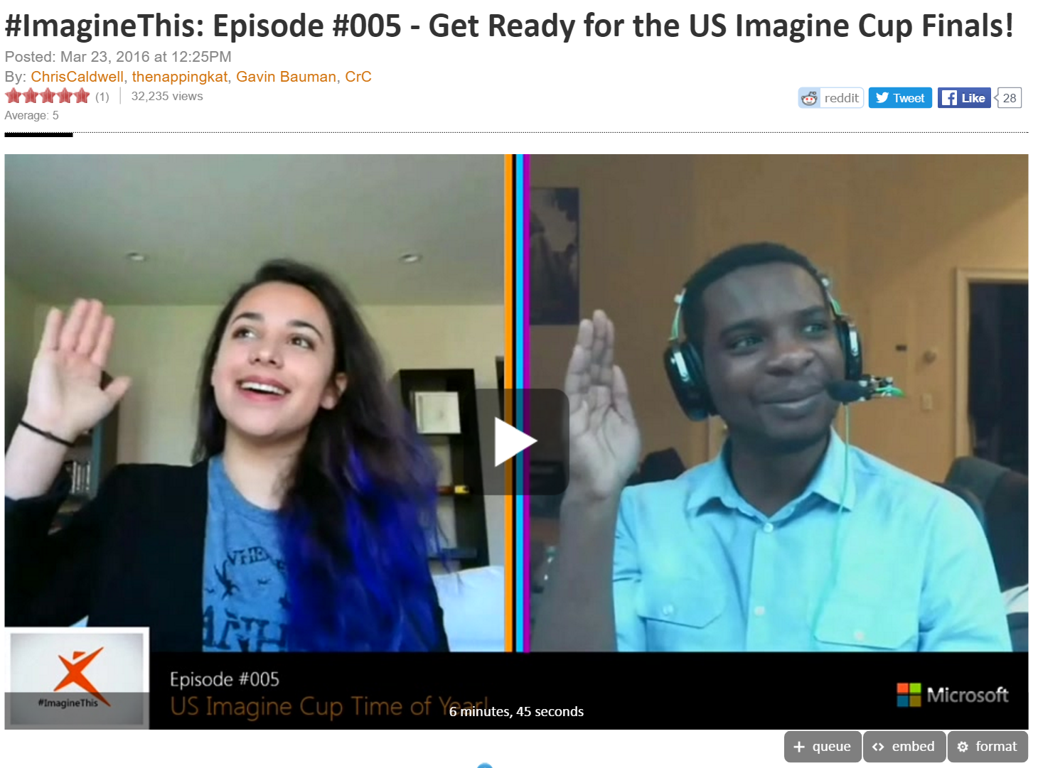
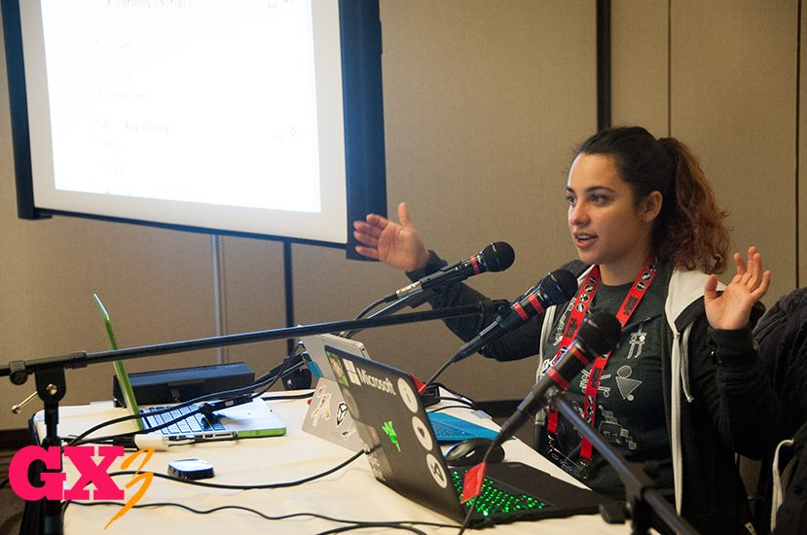

2015

Slide 4





Game Engines

Slide 5
Unity Editor
Layout
Project
Hierarchy
Scene
Game
Inspector
Navigation and Mouse Controls
Project Organization

Slide 6
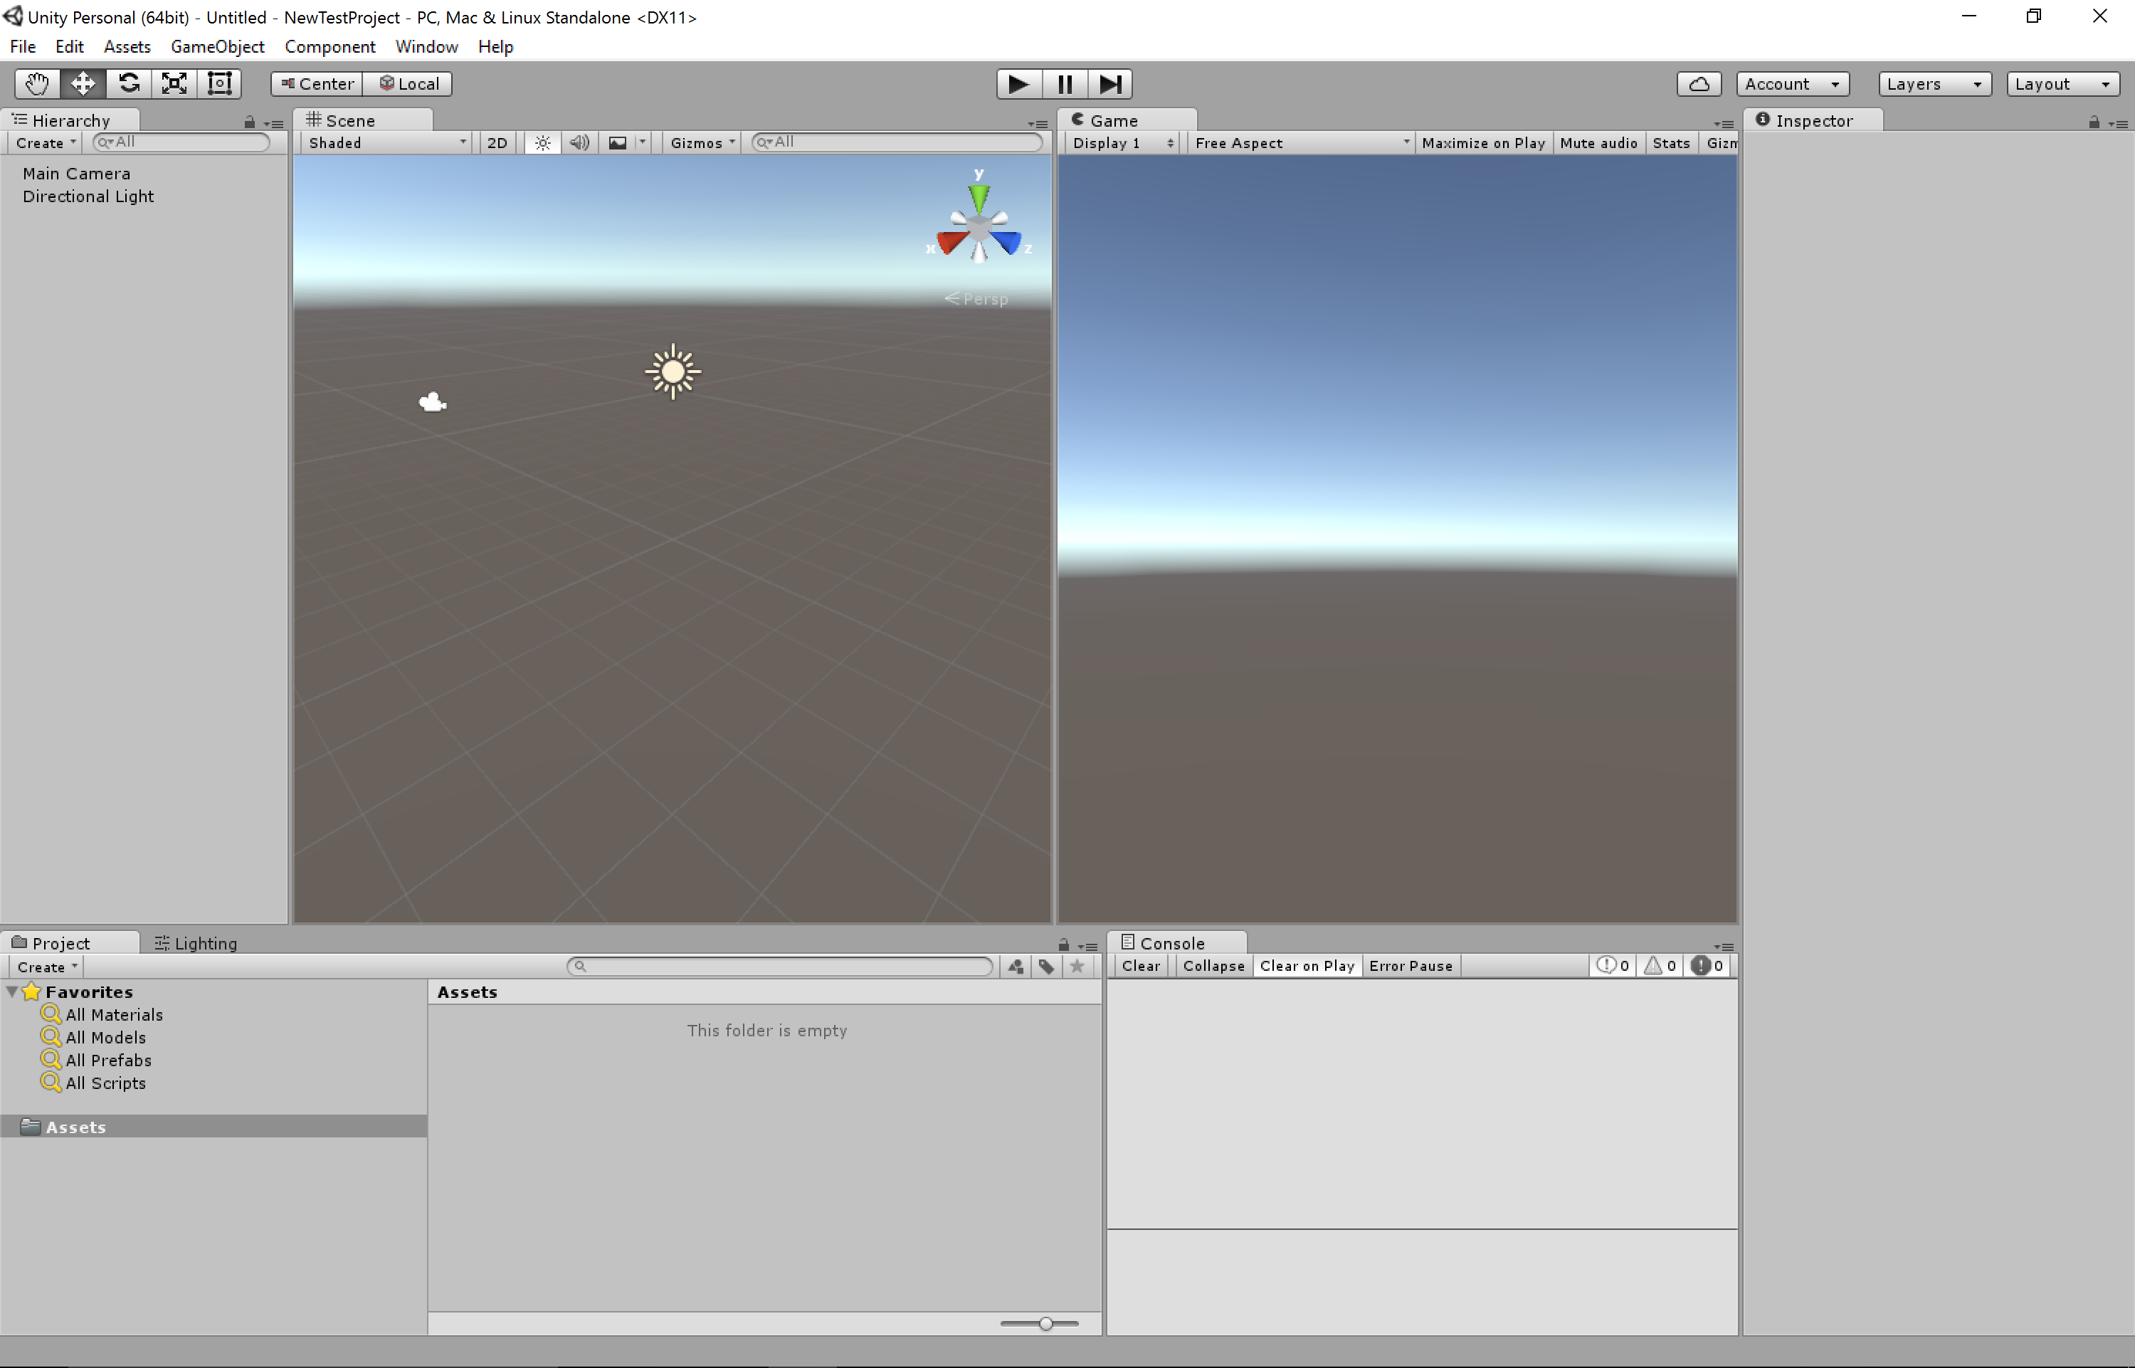

Slide 7
Importing Assets
Assets>Import Unity Assets
Characters
Environments

Slide 8
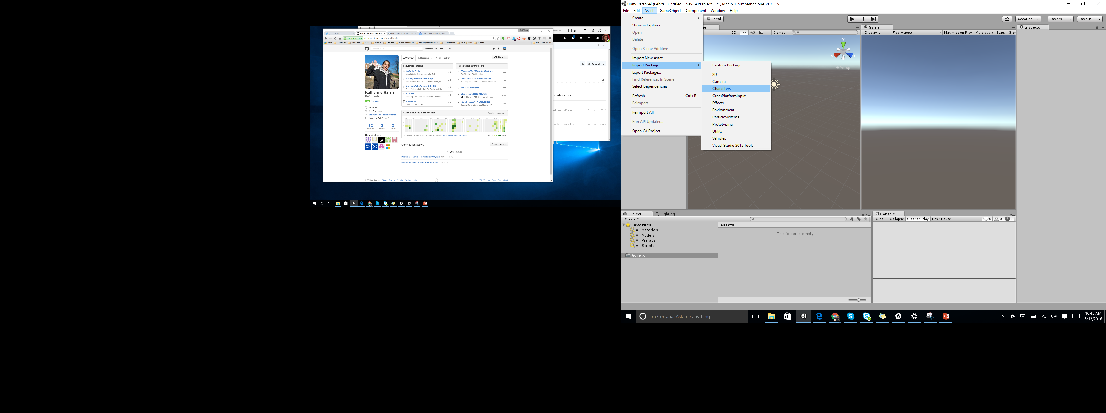

Slide 9
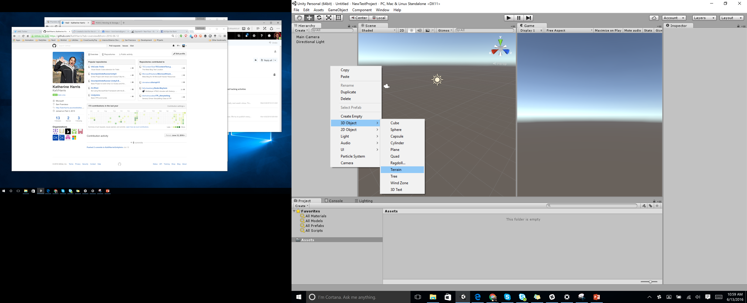
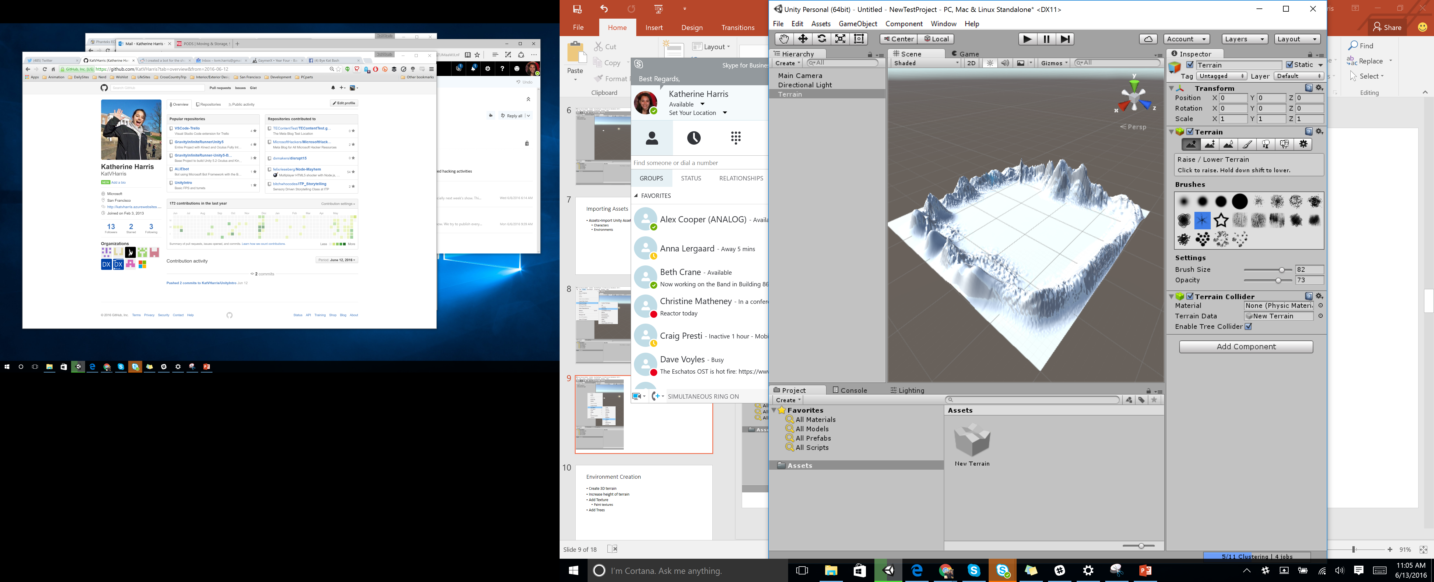

Slide 10
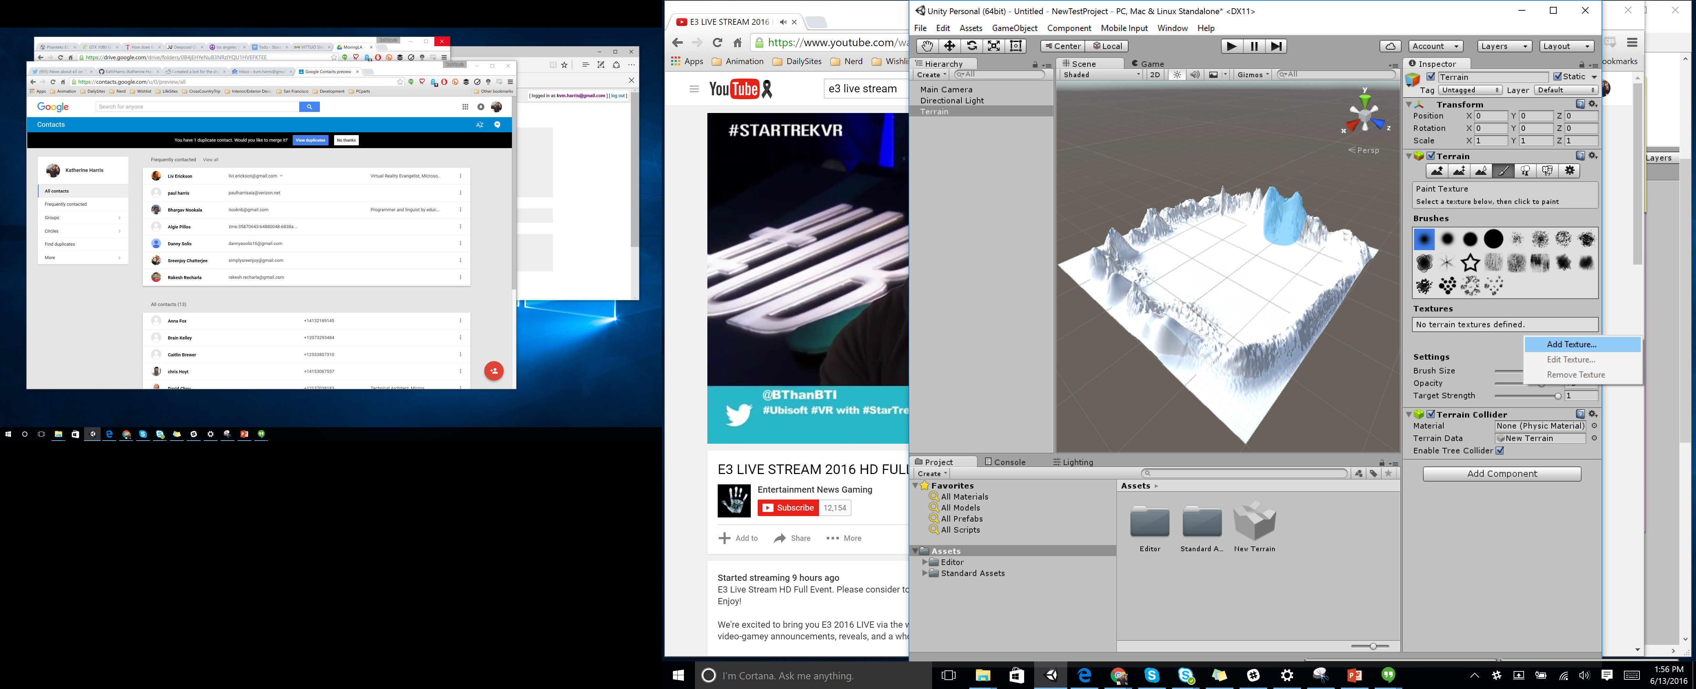
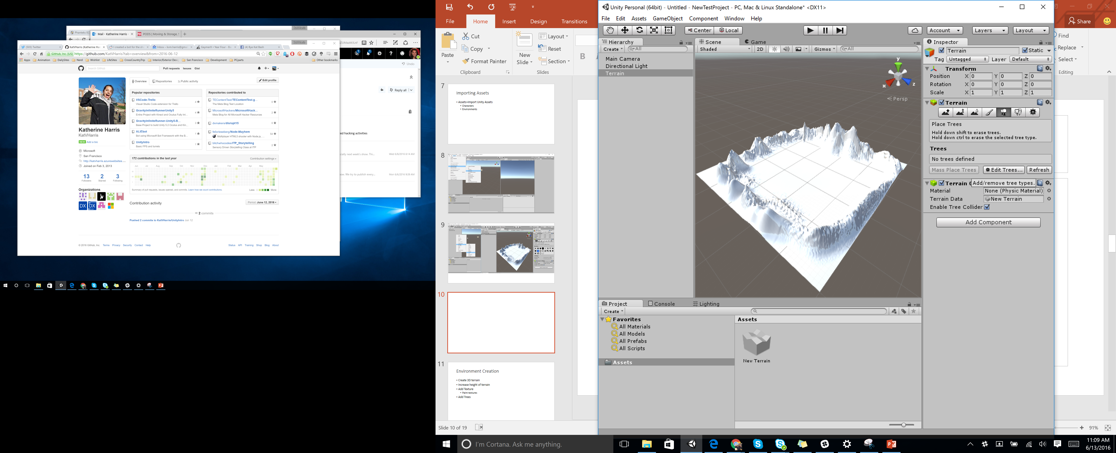

Slide 11
Environment Creation
Create 3D terrain
Increase height of terrain
Add Texture
Paint textures
Add Trees

Slide 12
Prefabs – Adding Player Character
Project Folder
Click and drag the First Person Controller Prefab into the Hierarchy

Slide 13
Object Interaction
Create New 3D Sphere Object

Slide 14
Trigger Object
Click isTrigger
Add code:

Slide 15
Create Prefab
Create sphere prefab

Slide 16
UI Creation
Create new UI - Canvas

Slide 17
Building Game

Slide 18
Shooting

Slide 19
Particle Effects

